Slide 1

Store Item Demand Forecasting

Slide 2
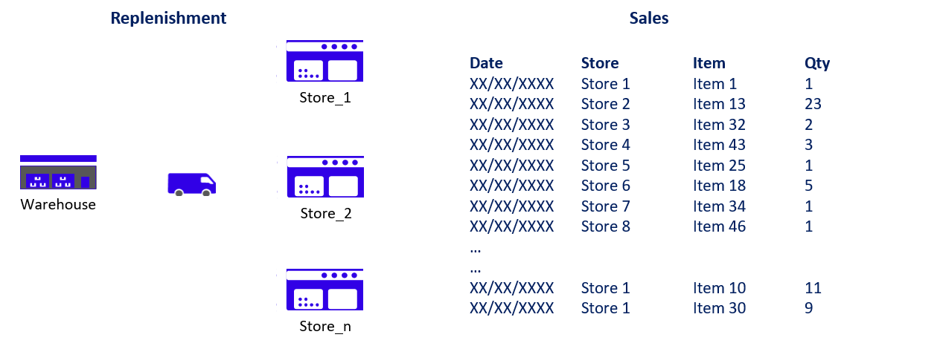
I. Demand Planning & Optimization Problem
This potential optimization can reduce operating costs by:
Inventory Optimization: matching store inventory to actual needs to reduce required storage space (Rental Costs)
Replenishment Optimization: optimizing replenishment per order to minimize the number of replenishments between warehouse and stores (Storage and Shipping Costs)
Let’s take a retailer with 50 stores as an example.
Transactions between 2013–01–01 and 2017–12–31
913,000 Sales Transactions
50 unique SKUs
10 stores

Slide 3
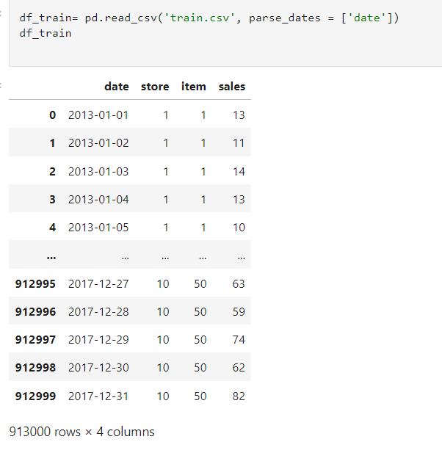

Slide 4

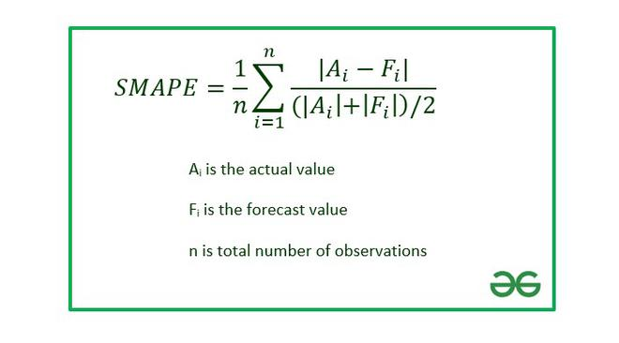
In this particular code example, the smape function was used during the training and evaluation of XGBoost models. SMAPE is a metric that measures the amount of error between the estimated values and the actual values in percentage terms.Dec.
SMAPE

Slide 5
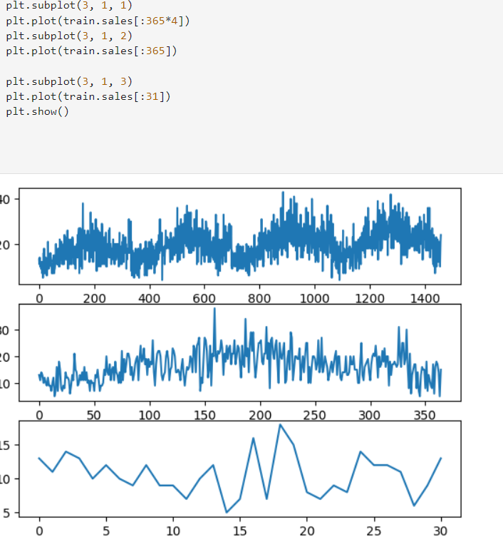
plt.plot(train.sales[:365*4]) the sales data of the first 4 years of the training dataset (365 days * 4) are drawn with the expression.
plt.plot(train.sales[:365]) expression is used to draw the sales data of the first year (365 days) of the training data set.
plt.plot(train.sales[:31]) the sales data of the first month (31 days) of the training data set are drawn with the expression.

Slide 6
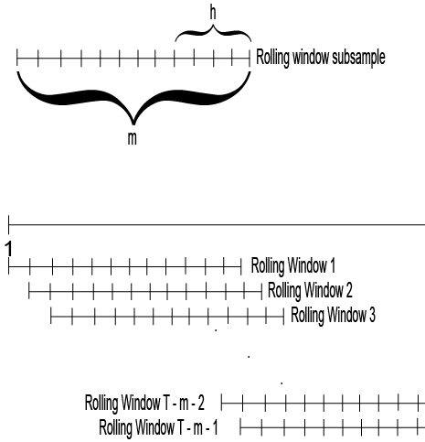
ROLLİNG WİNDOW
In time series analysis, often the recent delays have a higher predictive power than the old ones. Therefore, a model applied to the entire series (or to a subset of ‘education’) can belie several properties of the entire series. Therefore, the rolling window consists of the selection of a certain window size (by analyzing the Root Mean Square Error). For example, if the best window size is 24, we will apply the model to the example consisting of the first 24 observations; then in the second window, it consists of 2-25 observations; then 3-26 observations; and so on. The rolling window helps you to assess whether the parameters estimated by linear methods (intersections and slopes) are invariant over time.

Slide 7
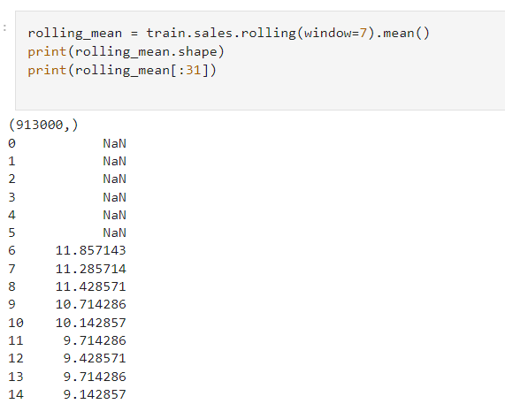
.the rolling(window=7) expression indicates that a moving average will be taken within this window by specifying a window size. Here, the window size is determined to be 7 days. .the mean() expression takes the average of the values in the window.

Slide 8
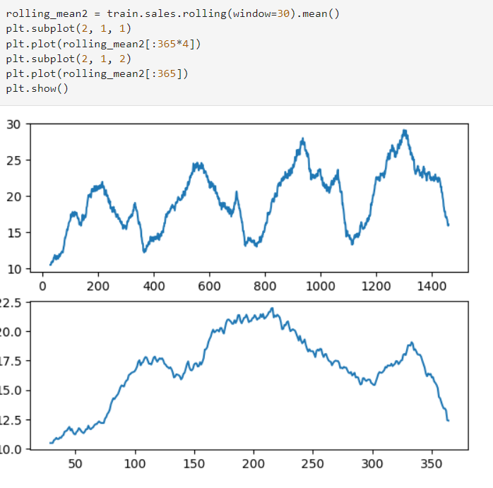

Slide 9

Time series can have the following components: Trend (Trend): It is the direction of long-term change of the time series. A trend represents the overall trend or an increase/decrease trend in the data set. Seasonality: These are patterns that repeat at certain intervals (such as day, week, December, month, year). For example, increases or decreases in sales of a particular product during a year can be called seasonality. Cycle: These are long-term patterns that repeat over a certain period of time but differ seasonally. They may include longer-term trends such as business cycles or economic cycles. Randomness (Noise): Represents random variations in a time series that are unpredictable and irregular.

Slide 10
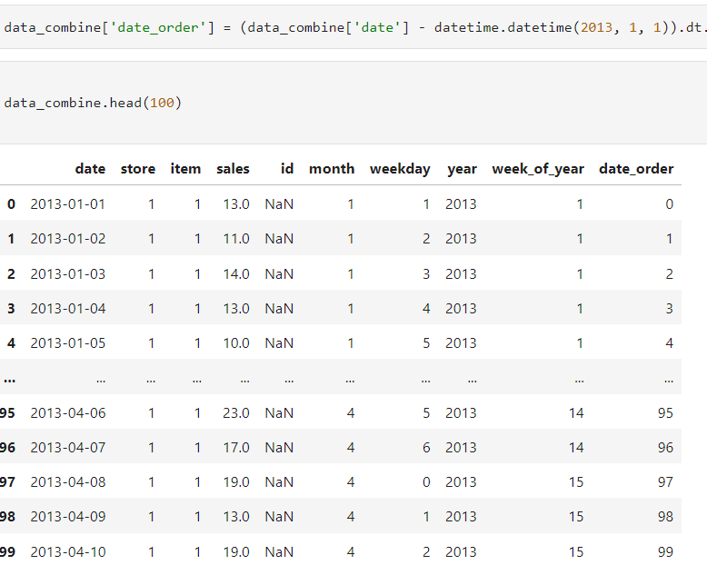
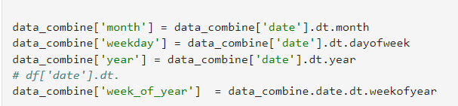

Slide 11
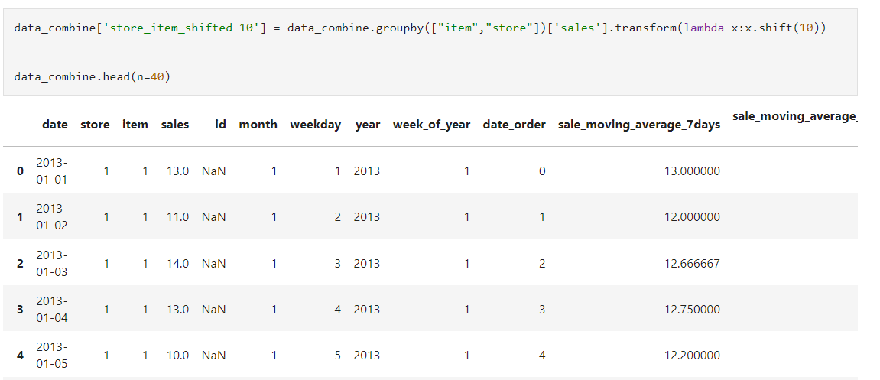
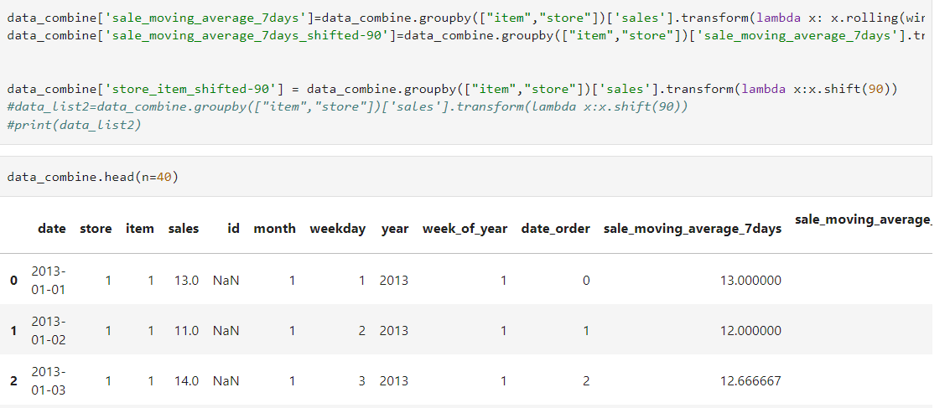

Slide 12
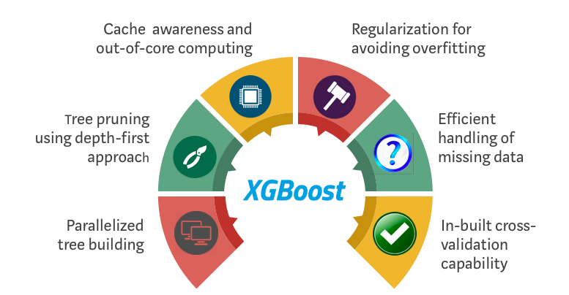
The XGBoost Algorithm
The basic working principle of the XGBoost algorithm is to add a new model in such a way as to minimize the errors of the existing model. For this, a step dimension is calculated based on the second derivative of the loss function. This step helps to adjust the output of the new model in such a way as to minimize the errors of the existing model.
L(y, ŷ ) + Ω(f)

Slide 13
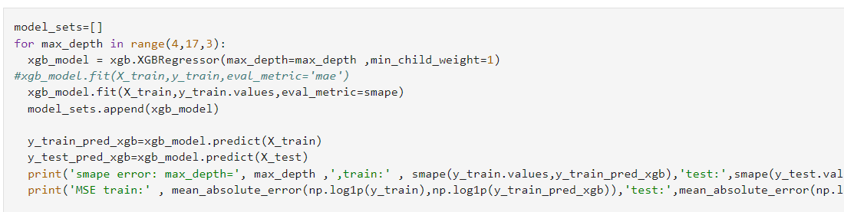

Slide 14
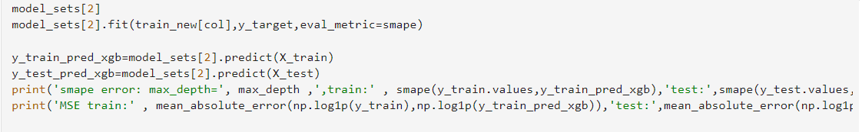

Slide 15
